Slide 1

Terminal Application – Rocks and Minerals
By Daniel Bailey

Slide 2
Overview of application
Features
Identifying rocks using database
Adding new rocks to database
Adding rocks to collection from database
Structure
Access all features from main menu
Selecting a feature will take the user through step-by-step on how to use it

Slide 3
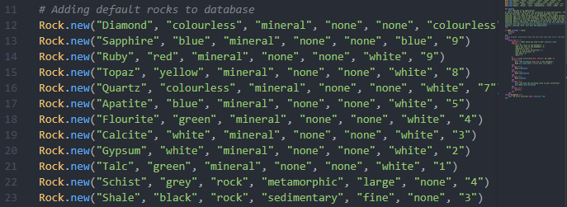
Overview of Code
Populating the database

Slide 4
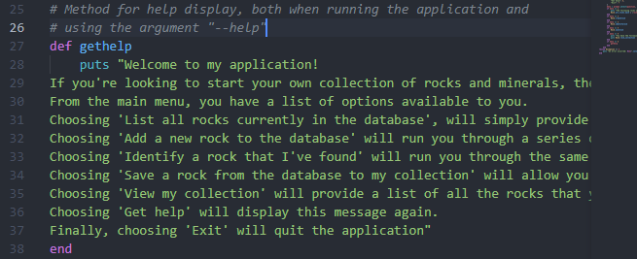
Overview of Code
Help method

Slide 5
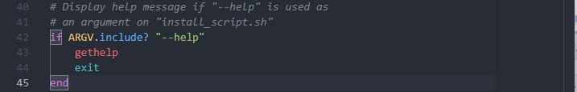
Overview of Code
Installation argument

Slide 6
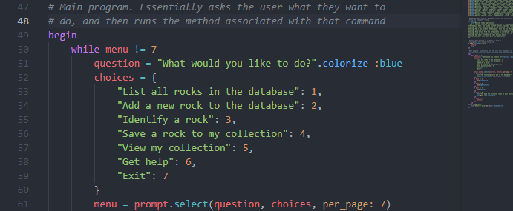
Overview of Code
Main program

Slide 7
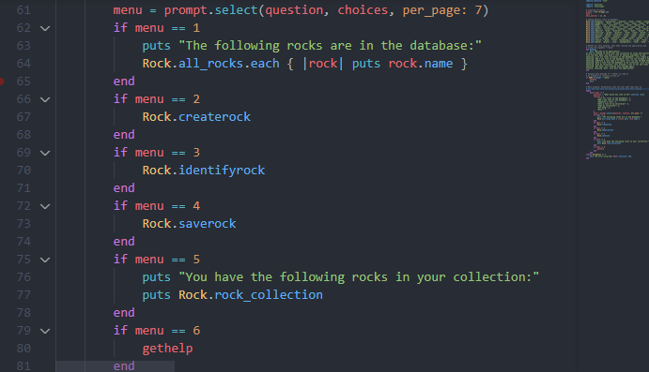
Overview of Code
Main program (continued)

Slide 8
Overview of Code
Main program (exception handling)

Slide 9
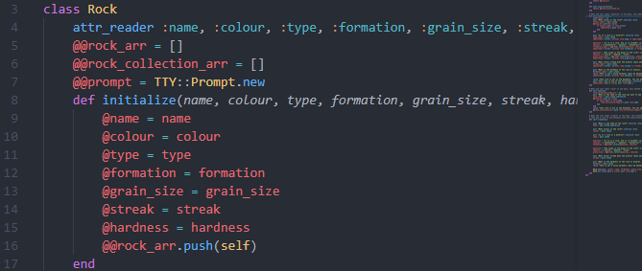
Overview of Code
Rock class (initialisation)

Slide 10
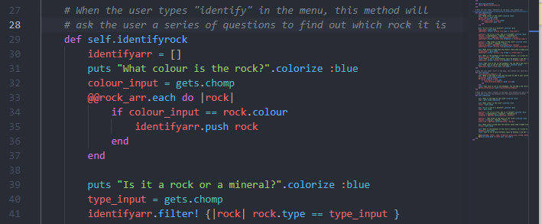
Overview of Code
Rock class (example method)

Slide 11

Overview of Code
Rock class (example method/ implementation of tty-prompt)

Slide 12
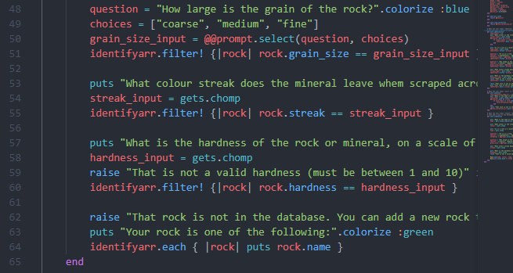
Overview of Code
Rock class (example method)

Slide 13
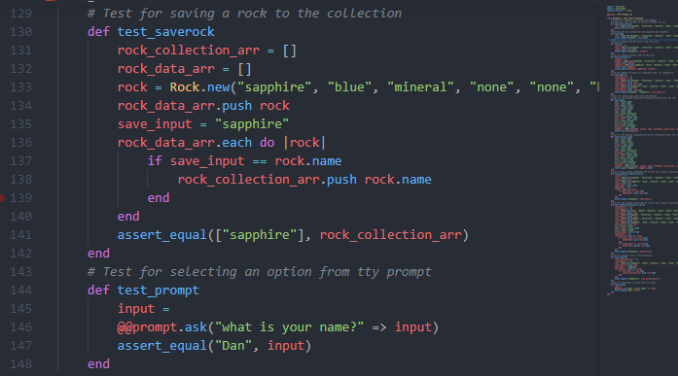
Overview of Code
Testing

Slide 14
Reflection
What I’ve learned/ struggled with
Testing is so important
Utilise classes more
Utilise Kanban more and follow it consistently
What I’ve loved
Gems are not as difficult as they seem and make life so much easier

